Slide 1
Graph Coloring Problem - Backtracking
PRESENTER:SRESTHA SADHU

Slide 2
Graph coloring
Vertex coloring is the most commonly encountered graph coloring problem. The problem states that given m colors, determine a way of coloring the vertices of a graph such that no two adjacent vertices are assigned same color.

Slide 3
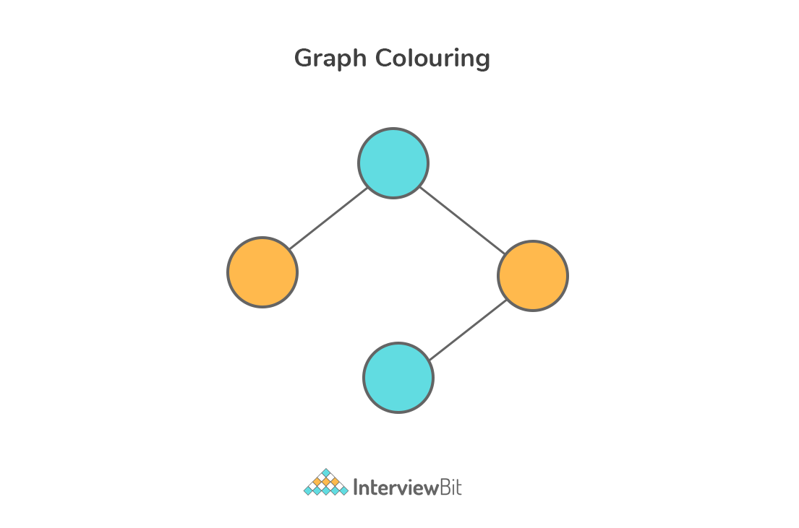
Note: The smallest number of colors needed to color a graph G is called its chromatic number. For example, the following undirected graph can be colored using minimum of 2 colors. Hence the chromatic number of the graph is 2.

Slide 4
Analysis
Input:
A graph represented in 2D array format of size V * V where V is the number of vertices in graph and the 2D array is the adjacency matrix representation and value graph[i][j] is 1 if there is a direct edge from i to j, otherwise the value is 0.
An integer m that denotes the maximum number of colors which can be used in graph coloring.

Slide 5
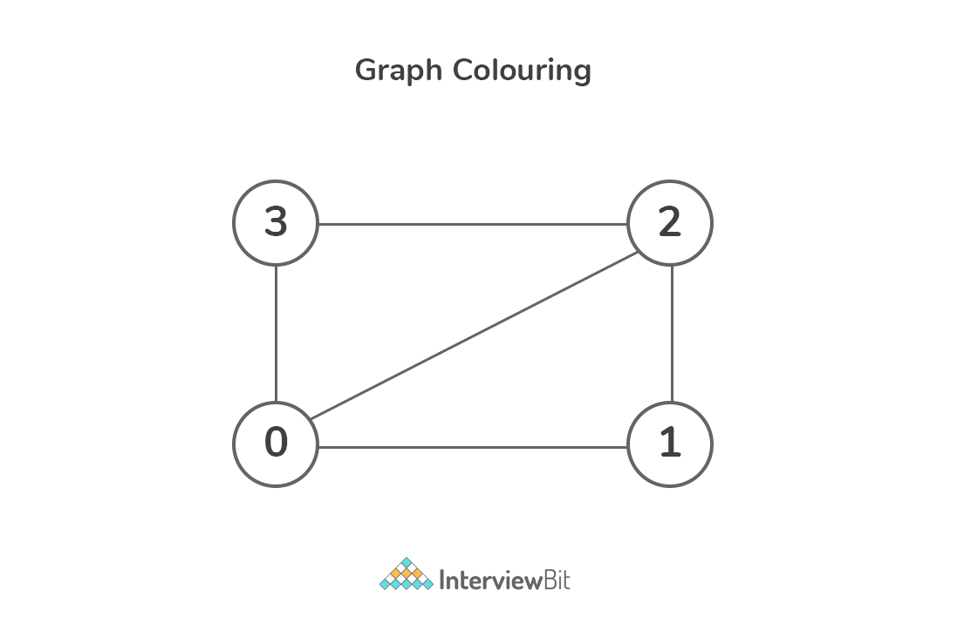
The above graph can be represented as follows:
graph[4][4] = { { 0, 1, 1, 1 },
{ 1, 0, 1, 0 },
{ 1, 1, 0, 1 },
{ 1, 0, 1, 0 }, };
Output:
Return array color of size V that has numbers from 1 to m.
Note that color[i] represents the color assigned to the i^{th} vertex.
Return false if the graph cannot be colored with m colors.

Slide 6
Backtracking
Backtracking is an algorithmic-technique for solving problems recursively by trying to build a solution incrementally, one piece at a time, removing those solutions that fail to satisfy the constraints of the problem at any point of time.
There are three types of problems in backtracking –
Decision Problem – In this, we search for a feasible solution.
Optimization Problem – In this, we search for the best solution.
Enumeration Problem – In this, we find all feasible solutions.

Slide 7
How to determine if a problem can be solved using Backtracking?
Consider a situation that you have three boxes in front of you and only one of them has a gold coin in it but you do not know which one.
So, in order to get the coin, you will have to open all of the boxes one by one.
You will first check the first box, if it does not contain the coin, you will have to close it and check the second box and so on until you find the coin.
This is what backtracking is, that is solving all sub-problems one by one in order to reach the best possible solution.

Slide 8
Graph coloring Using Backtracking
By using the backtracking method, the main idea is to assign colors one by one to different vertices right from the first vertex (vertex 0).
Before color assignment, check if the adjacent vertices have same or different color by considering already assigned colors to the adjacent vertices.
If the color assignment does not violate any constraints, then we mark that color as part of the result. If color assignment is not possible then backtrack and return false.

Slide 9
1
2
X1=r
X1=red
4
3
X2=r
G
B
R
G
B
R
R
G
B
G
R
G
R
B
B

Slide 10
THANK YOU

